Slide 1
Digital Logic Design and Application
Chen Yan
Lecture #03
Topic 2-1 Combinational circuits design
——principles

Slide 2
Topic 2-1 combinational circuits design
Principles
Applications
* Logic levels and Gates
Standard Combinational components
Verilog for combinational components
Switching Algebra
logic functions
combinational circuit analysis and design

Slide 3
Logic Signals and Gates
Digit logic hide the pitfalls of the analog world by mapping the infinite set of real values for a physical quantity into two subsets corresponding to just two possible numbers of logic ：0 and 1
Question1：How?
Infinite set of the real world
Two values in the Digital Logic world
logical abstraction：
  Number system
  Coding

Slide 4
Logic abstraction & logic convention
Real world
Logic world
positive logic
1
electrical function table
of invertors
A F
0 1
1 0
F=A’
A Y=A’
L H
H L
Logic
abstraction
0
Negative logic
0
L：0-1.5V
H：3.5-5V
G=A’
A G
1 0
0 1
1
Notes:
If it’s not claimed we usually use positive logic conventions in analysis and design afterwards.

Slide 5
Question 2：Write the truth table for this logic gate in positive and negative logic convention.
Function table
A B F
L L L
L H L
H L L
H H H

Slide 6
Logic Level
  Physical realization of Logic 1 and 0
    How to get the HIGH and LOW Voltage
Use transistors as the on-off circuits.
Vcc
+ V_{DD}
R
L (0)
R_{D}
If input is L, the transistor is “off” and output is H.
If input is H, the transistor is “on”, output is L.
This on-off Circuit is fact a NMOS invertor (NOT gate).
V_{OUT}
D
+
H (1)
V_{IN}
G
i_{D}
v_{O}
+
On (1)
v_{I}
S
–
–
Off (0)
Basic MOS on-off Circuit

Slide 7
Basic CMOS on-off Circuit
V_{CC}
ON when input is low
+ V_{DD}
controllable resistor
R_{On}：200 Ω
R_{off}: 1M Ω
R_{D}
Vout
D
+
G
Vin
i_{D}
v_{O}
+
v_{I}
S
ON when input is high
–
–
CMOS invertor is active pull-up
MOS transistors act like voltage-controlled resistances.
Passive pull-up
NMOS invertor
Notes:
It’s hard to set the value of Rd to ensure both perfect H and L level. While a CMOS transistor which works as controllable resistor can do the job well. we use a P type CMOS transistor to take place of Rd. Then we can get both perfect H and L levels.

Slide 8
Logic levels
CMOS Logic Levels : Logic 1s and 0s in fact correspond to an acceptable range of voltage change.
5.0V
30% V_{DD}
Logic 1 (HIGH)
Logic 0 (LOW)
3.5V
H_{Min}
undefined logic level →
1.5V
L_{Max}
30% V_{DD}
0.0V
A CMOS Logic Circuit uses not only 5-Volt power-supply voltage, but other power-supply voltages, such as 3.3, 2.7 volts.

Slide 9
Logic Families
Semiconductor diode
Bipolar junction transistor
Bipolar logic family
Transistor-transistor logic, TTL
Metal-oxide semiconductor field-effect transistor, MOSFET,
Complementary MOS, CMOS

Slide 10
Logic Families
  A logic family is a collection of different IC chips that have similar input, output, and internal circuit characteristics, but that perform different logic functions.
  Chips of same family can be connected to perform arbitrary logic functions.
  Chips from different families may not be compatible.
  Logic families differ in speed, power consumption and load ability.

Slide 11
Logic level
Question 3：Find the H and L range?
A NAND Gate Data Sheets and Specifications 74HC00

Slide 12
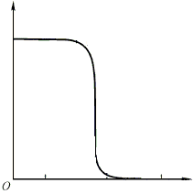
DC Noise Margin
Voltage transfer curve of invertors
V_{out}
H
L
V_{in}
L
UD
H

Slide 13
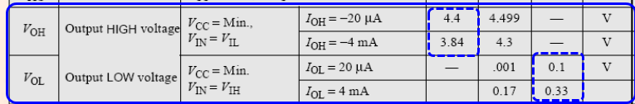
DC Noise Margins
V_{out}
Min
Max
V_{OH}
H
4.4
0.1
V_{IH}
V_{OL}
L
V_{in}
L
UD
H
1.35
3.15
V_{IL}

Slide 14
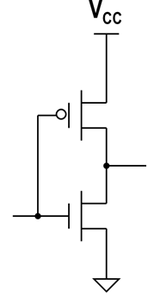
DC Noise Margin
V_{OH}
V_{IH}
V_{IL}
V_{out}
V_{OL}
V_{In}

Slide 15
DC Noise Margin
DC noise margin（直流噪声容限） is the voltage amount by which the signal dose not exceed the threshold for a proper logic '0' or '1'.
HIGH
ABNOMAL
LOW
V_{OHmin}
High-state DC noise margin
V_{IHmin}
V_{ILmax}
Low-state DC noise margin
V_{OLmax}

Slide 16
DC Noise Margins
Question 4：Compute the DC noise margins for this circuit.
High-state DC noise margin：4.4-3.15=1.25 V
Low-state DC noise margin：1.35-0.1=1.25 V

Slide 17
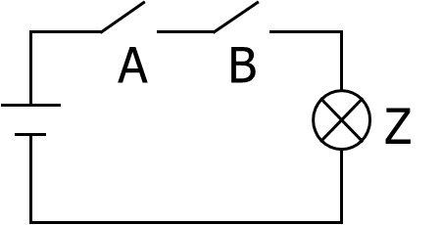
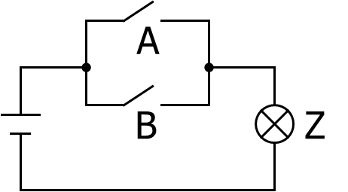


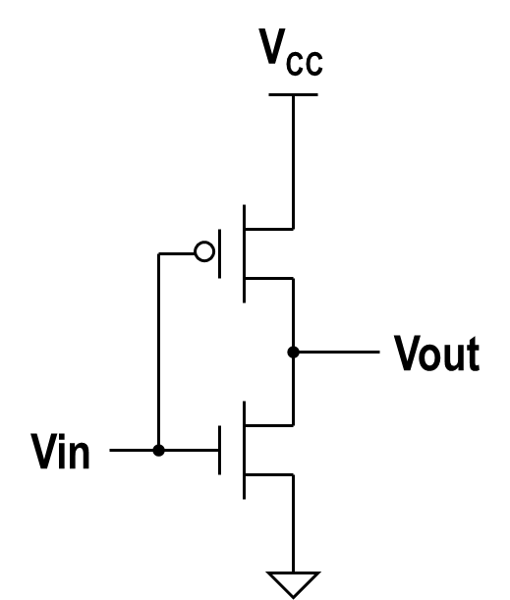
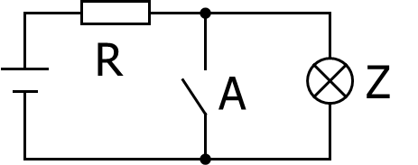

Logic Gates
Z = A · B
Z = A + B
AND gate
OR gate
NOT gate
Z = A’

Slide 18
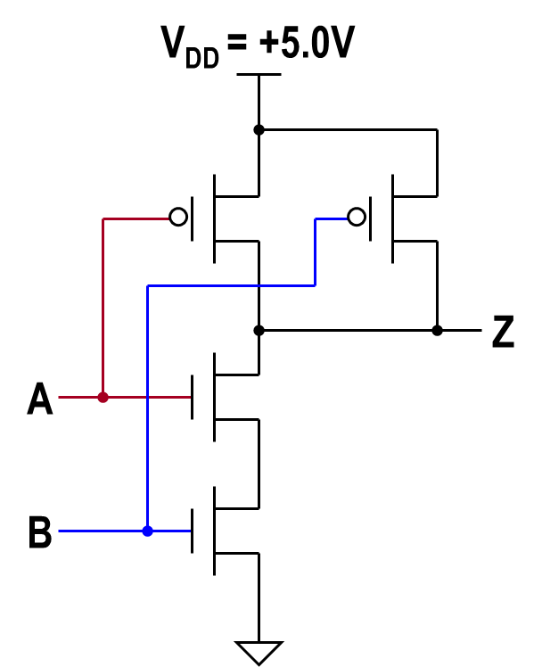
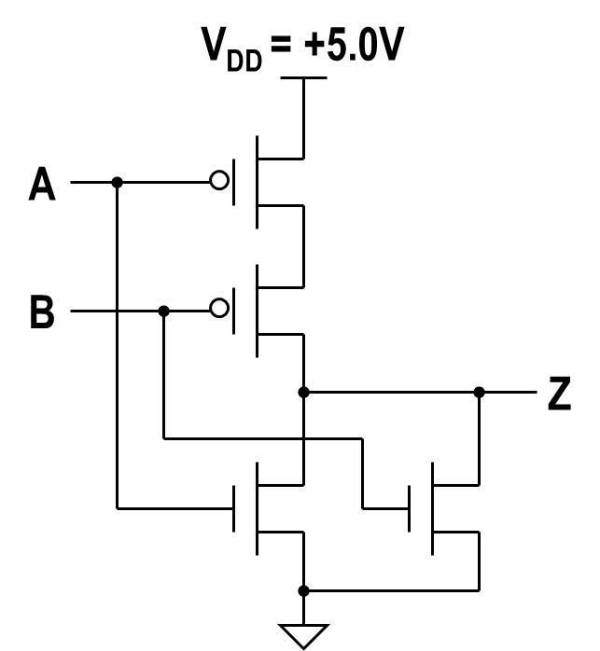
CMOS Logic Gates
Z = (A + B)’
Z = (A · B)’
NAND(与非) gate
NOR（或非） gate
Question 5：How to get a AND gate ?
Notes:
An AND operation can be performed by connect a NAND gate with a NOT gate. An OR operation can be performed by connect a OR gate with a NOT gate.

Slide 19
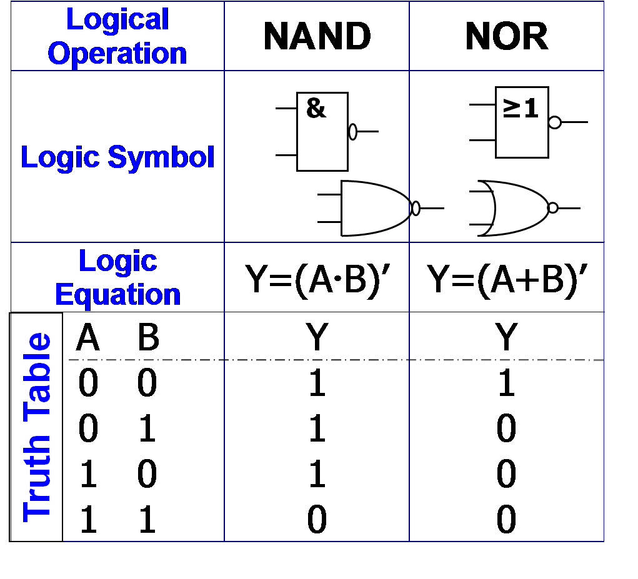
Logic Gates

Slide 20
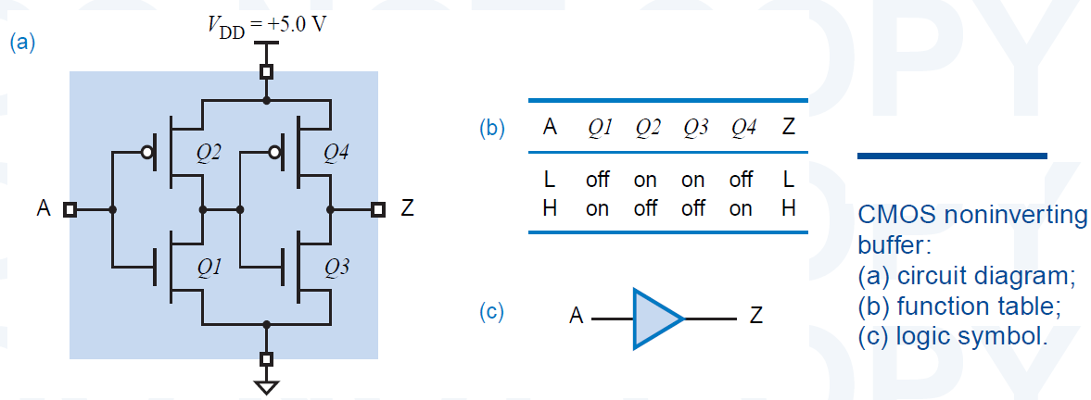
Logic Gates with non-inverting outputs
CMOS buffer（缓冲器）

Slide 21
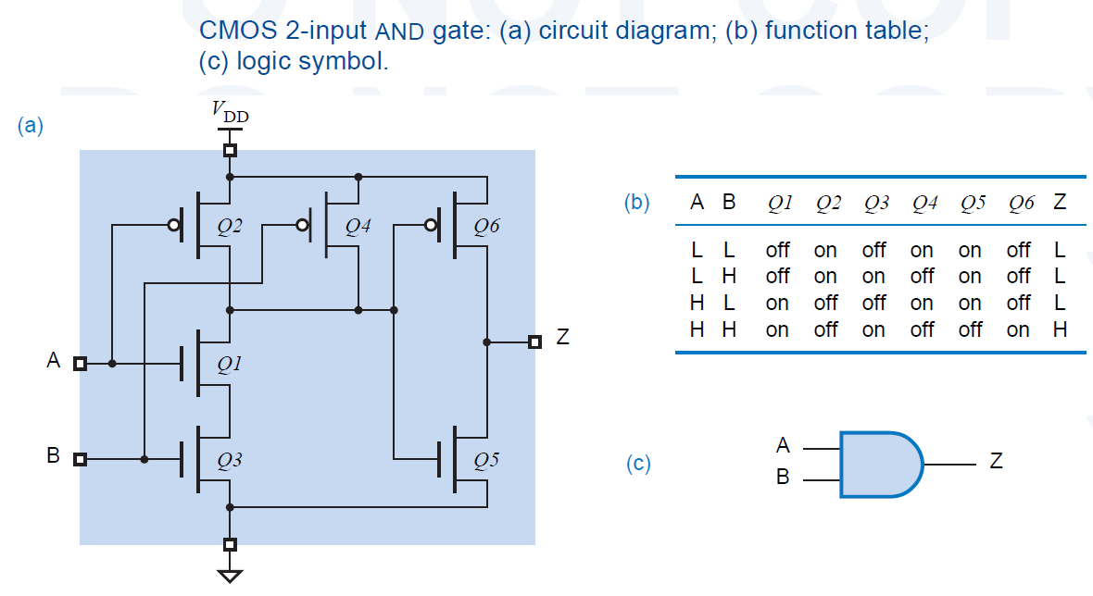
Logic Gates with non-inverting outputs
CMOS AND gate

Slide 22
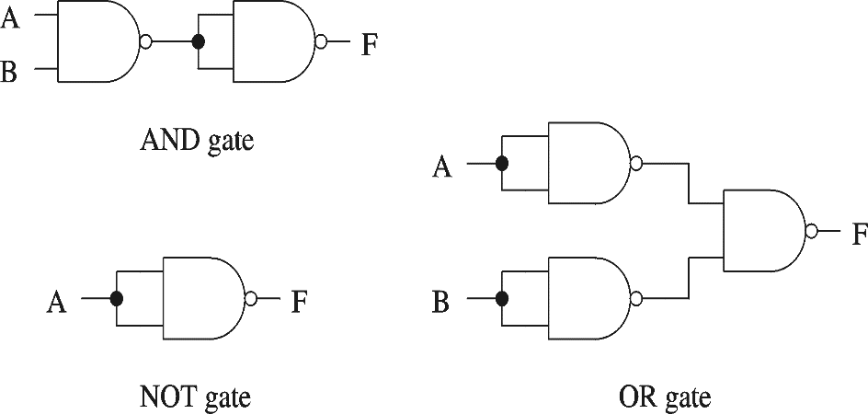
Basic Logic operation / gates
An operation (gate) set is COMPLETE（完备） if any logic function can be realized by using logic operations (gates) in the set.
Minimal Complete set(最小完备集): a complete set with no redundant elements.
Examples
{AND, OR, NOT}
{NAND}
{NOR}
Simplest and Lowest Cost
Question 5：Is {AND，OR，NO} a minimal complete set?
Notes:
Minimal Complete Set={AND,NOT}, {OR,NOT}

Slide 23
Fan In （扇入）
CMOS NAND --- more inputs (3)
Z = (A · B · C)’
Z = (X1 · X2·…·Xn)’
→Use 2n transistors for n-input gate
Inputs can’t be added unlimitedly ---FAN IN

Slide 24
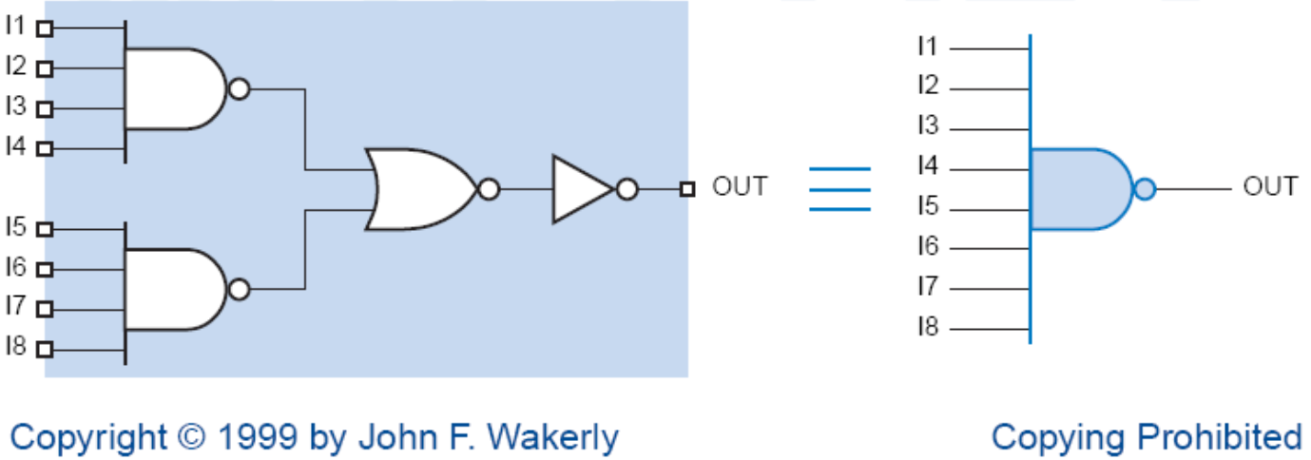
Fan In（扇入）
The maximal number of inputs that a gate have is called fan-in.
The additive “on” resistance of series transistors limits the fan-in of CMOS gates. Typically, Fan-In is 4 for NOR gates and 6 for NAND gates.
Gates with a large number of inputs can be made by cascading gates with fewer inputs.

Slide 25
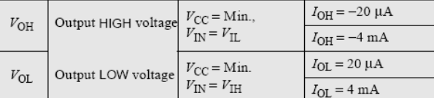
Fan out（扇出）
Fan-out of a logic gate output is the maximal number of gate inputs it can connect to without exceeding its worst-case loading specifications.
Fan-out must be examined for both possible output states, HIGH and LOW.
  fan-out = min (HIGH-state, LOW-state fan-out)
  For CMOS load the Fan Out is not a problem
  For Other load the Fan Out must be carefully examined
Notes:
For outputting a H level an Ic circuit need to charge the following inputs to H level with providing current, so the parameter is negative in the datasheet;
For outputting a L level an Ic circuit need to discharge the following inputs to L level with absorbing current, so the parameter is positive in the datasheet;

Slide 26
V_{CC}
Vout
Vin
Explain Board for Fan Out parameter

Slide 27
Example: compute the fan-out for 74HCT driving 74LS
CMOS: 74HCT
I_{OH} = – 4 mA
I_{OL} = 4 mA
I_{IH} = 1 μA
I_{IL} = – 1 μA
TTL: 74LS
I_{OH} = – 400 μA
I_{OL} = 8 mA
I_{IH} = 20 μA
I_{IL} = – 0.4 mA
LOW state Fan-Out
HIGH state Fan-Out
Fan-out
Question 6：Why Fan-out is not 200?
Notes:
For 74HCT use the output parameters, for 74LS use the input parameters.

Slide 28
Reference
“Digital Design: Principles and Practices", 4th Edition, John F. Wakerly, Chap. 3.

Slide 29
Topic 2-1 combinational circuits design
Principles
Applications
*Logic levels and Gates
Standard Combinational components
Verilog for combinational components
Switching Algebra
logic functions
combinational circuit analysis and design

Slide 30
Switching Algebra-Axioms
a.k.a. “Boolean algebra”
  A1: X = 0, if X ≠ 1 X = 1, if X ≠ 0
  A2: 0’ = 1 1’ = 0
  A3: 0·0 = 0 1+1 = 1
  A4: 1·1 = 1 0+0 = 0
  A5: 0·1 = 1·0 = 0 1+0 = 0+1 = 1
  Precedence: ( )>NOT > AND > OR

Slide 31
Single-Variable Theorems
The operations between variable and constant
Identities(自等律): X+0=X X·1=X
Null Elements(0-1律): X+1=1 X·0=0
Involution(还原律): ( X’ )’ = X
Idempotency(同一律): X+X=X X·X=X
Complements(互补律): X+X’=1 X·X’=0
The operations between variable and itself and it’s complement.

Slide 32
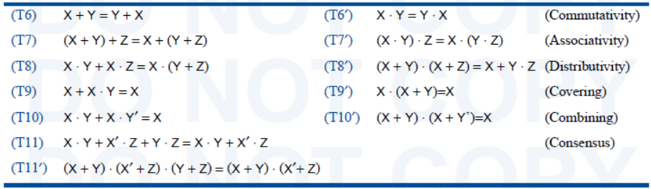
Two- and Three-Variable Theorems
交换律
结合律
分配律
吸收律
组合律
一致律

Slide 33
Notices
No logic power law A·A·A ≠ A³
No logic dividing
if A·B=B·C ➔ A=C ??
Wrong!
A=1, B=0, C=0
A·B=A·C=0, A≠C
No logic subtraction
if A+B=A+C ➔ B=C ??
Wrong!
A=1, B=0, C=1
A+B=A+C, B≠C

Slide 34
Some Special Theorems
T9~T11
Covering (吸收律)
X + X·Y = X X·(X+Y) = X
Combining (组合律)
X·Y + X·Y’ = X (X+Y)·(X+Y’) = X
Consensus (添加律/一致性定理)
X·Y + X’·Z + Y·Z = X·Y + X’·Z
(X+Y)·(X’+Z)·(Y+Z) = (X+Y)·(X’+Z)
Notes:
All the theorems can be proofed by truth table, Boolean algebra or set theory.

Slide 35
n-Variable Theorems
DeMorgan’s Theorem （德·摩根定理）
—— Complement Theorem
X_{i} can be
replaced by
any expression
(A · B)’ = A’ + B’
(A + B)’ = A’ · B’

Slide 36
Equivalent gates
Notes:
Using DeMorgan’s law and equivalent gates digital circuits can be transformed to different structures.

Slide 37
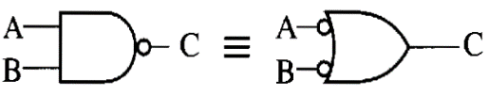
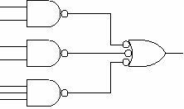

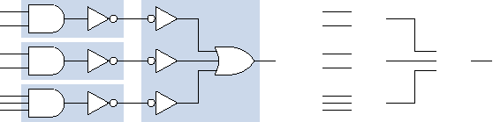
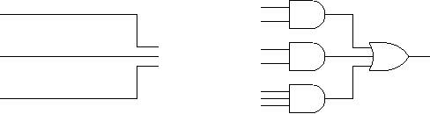
Circuit Manipulation using DeMorgan’s Law
Designing with NAND gates
Double inversion cancels
AND-OR
NAND-NAND

Slide 38

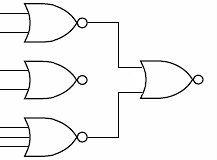
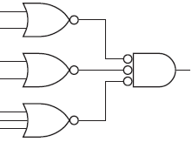
Circuit Manipulation using DeMorgan’s Law
Designing with NOR gates
Double inversion cancels
OR-AND circuit → NOR-NOR circuit

Slide 39
DeMorgan’s Theorem
Complement of a logic expression:
   ⇔ , 0 ⇔ 1, Complementing all Variables
  Keep the previous priority
  Notice the ’ out of parentheses
Example1: Write the complement function for each of
the following logic functions.
F1 = A·(B+C)+C·D F2 = (A·B)’+C·D·E’
F1’ = (A’+B’·C’)·(C’+D’)
F2’ = (A’+B’)’·(C’+D’+E)
F2’ = A·B·(C’+D’+E)
Notes:
When a logic function F is complicated it’s complement F’ might be simple, and we can implement this logic function by negating the output of F’.

Slide 40
Duality（对偶）
T9 and T9’: Covering Law
X + X·Y = X X·(X+Y) = X
Duality Rule
   ⇔ , 0 ⇔ 1
  Keep the previous precedence
F^{D}(X₁ , X₂ , … , X_{n} , + ,  , ’ )
= F(X₁ , X₂ , … , X_{n} ,  , + , ’ )

Slide 41
Duality
F^{D}(X₁ , X₂ , … , X_{n} , + ,  , ’ ) = F(X₁ , X₂ , … , X_{n} ,  , + , ’ )
  0^{D}=1，1^{D}=0； X^{D}=X；
  For function F and G
  （F+G）^{D}= F^{D}·G^{D}； （F ·G）^{D}= F^{D}+ G^{D}
  （F ^{D} ）^{D}=F
  If F=G，then F^{D} =G^{D} , vice versa.

Slide 42
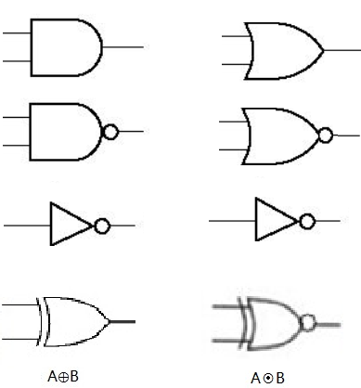
Duality
Dual gates

Slide 43
Duality
Counterexample:
    X+X·Y = X
    X·X+Y = X
    X+Y = X
X·(X+Y) = X
Example: Write the Duality function for each of the following Logic functions.
F1 = A+B·(C+D)
F2 = ( A’·(B+C’) + (C+D)’ )’
F1^{D} = A·(B+C·D)
F2^{D} = ( (A’+B·C’) · (C·D)’ )’

Slide 44
Duality and Complement
  Complement:
  [ F(X₁ , X₂ , … , X_{n}) ]’ = F^{D}(X₁’ , X₂’, … , X_{n}’ )
By complementing the variables in the dual function one can get the complement expression of a logic function.
positive logic
F = A·B
A B F
F^{Ｄ} = A＋B
0 0 0
0 1 0
1 0 0
1 1 1
F ’= A’＋B’
F’=F^{D} ( A’，B’)

Slide 45
Duality and Complement
Eg. Write the duality and complement function for the following logic functions.
F1 = A’·(B+C) + C’·D
F1^{Ｄ} = (A’+(B·C) ) · (C’+D )
F1’= (A+(B’·C’) ) · (C+D’ )
Notes:
Duality provide us a way of getting the complement function.

Slide 46


Duality and Applications
Once you have the And-Or representation of a circuit it is very easy to get the OR-AND representation of the same circuit.
[ F(X₁ , X₂ , … , X_{n}) ]’ = F^{D}(X₁’ , X₂’, … , X_{n}’ )
F(X₁ , X₂ , … , X_{n}) = [F^{D}(X₁’ , X₂’, … , X_{n}’ )]’
F =[ F^{Ｄ}(A ’,B ’,C’ ) ]’
=[ (A’+B’) ·C’ ] ’
F=AB+C
A
B
F’
F
A
B
F
F’
C
C
And-OR circuit
OR- And circuit
Notes:
Duality provide us a method to implementate the same logic function with different circuit structure.

Slide 47
Duality and Applications
Replace each gate with it’s dual gate and negates all inputs and outputs.
F(X₁ , X₂ , … , X_{n}) = [F^{D}(X₁’ , X₂’, … , X_{n}’ )]’
A
B
F
A
B
F
C
C
And-OR circuit
OR- And circuit
NAND circuit
NOR circuit
Question 7：How to keep the precedence in the circuit transformation?

Slide 48
Reference
“Digital Design: Principles and Practices", 4th Edition, John F. Wakerly, Chap. 4.

Slide 49
Backups

